Slide 1


Slide 2
We are a Multi-disciplinary Advertising Agency, based in Guwahati, India, specializing in Brand Identity Design to Media Planning & Execution.
For over a decade we have developed creative solutions for clients across various sectors such as Govt. Dept. Education, Retail, Fashion, Entertainment, and Human Development.
WHAT WE DO

Slide 3
OUR SERVICES
Outdoor Media Campaign
Social Media Campaign
Digital Marketing
Electronic Media Campaign
360- degree Advertising campaign
Print Media Campaign
Exhibition Design
Events
Video Production

Slide 4
RESEARCH
Discussions
ideation
Feedback systems
STRATEGY
Design
Implementation
creative conceptualization
Precise reporting system
Review and Optimization
OUR PROCESS

Slide 5









OUR ESTEEMED CLIENTS

Slide 6













OUR ESTEEMED CLIENTS

Slide 7
















OUR ESTEEMED CLIENTS

Slide 8







OUR ESTEEMED CLIENTS

Slide 9
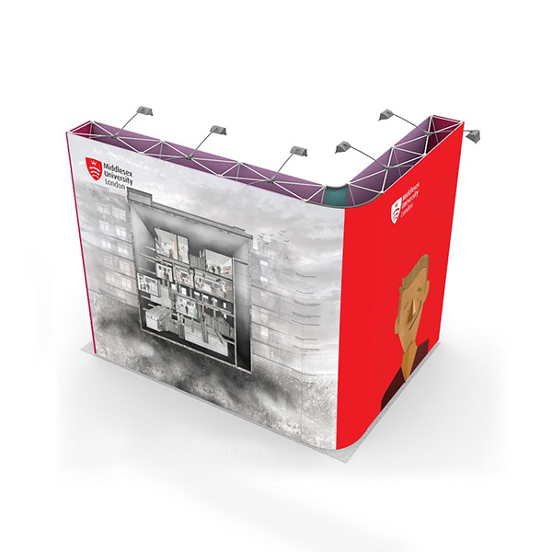
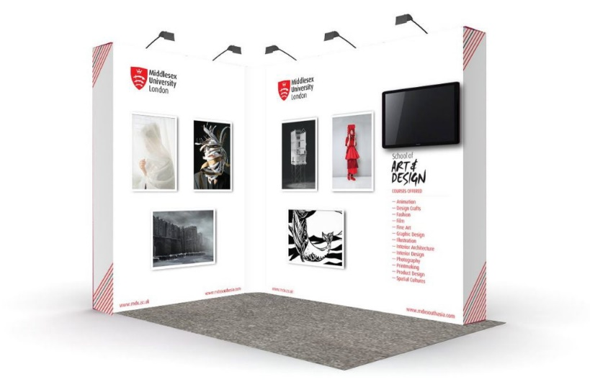


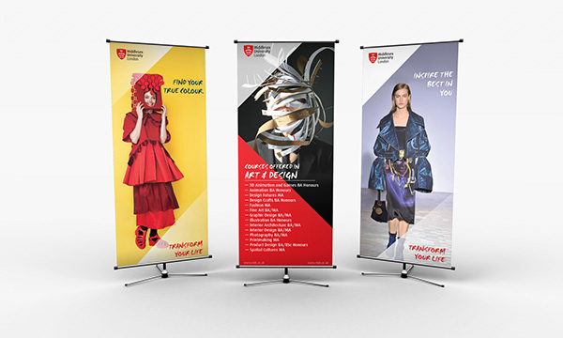



Work Samples
Samples of work, design, Print, Media campaigns.
Regional, National and International.

Slide 10



Work Samples
Samples of work, design, Print, Media campaigns.
Regional, National and International.

Slide 11



Work Samples
Samples of work, design, Print, Media campaigns.
Regional, National and International.

Slide 12
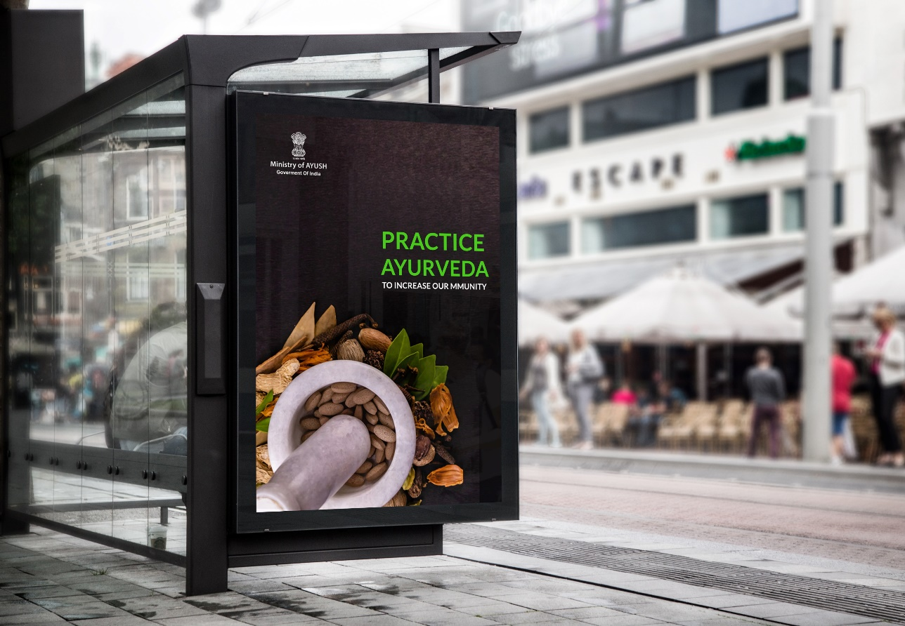
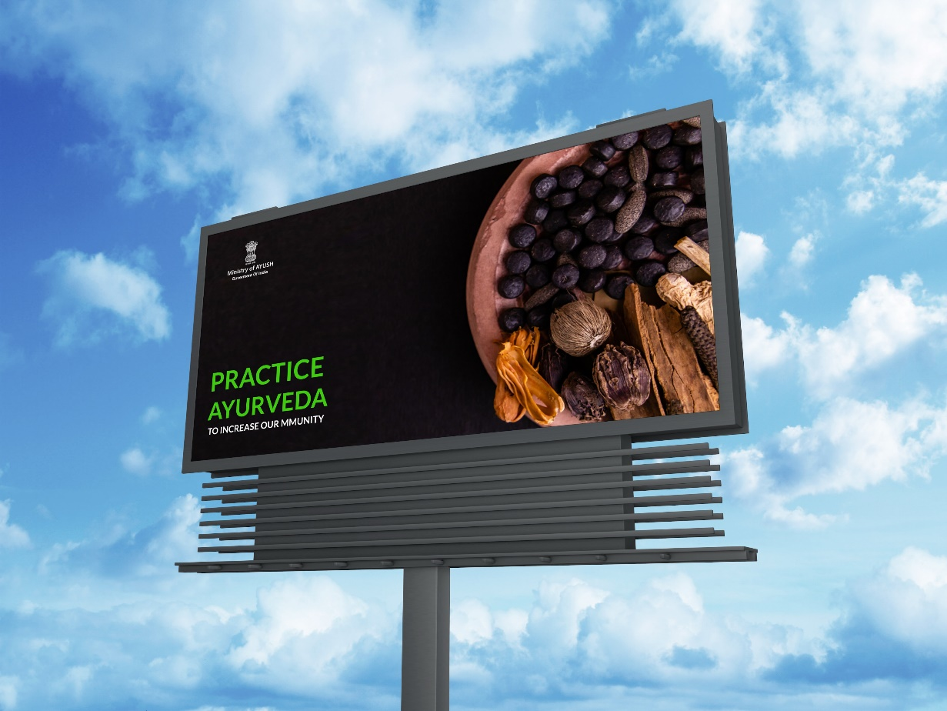
Work Samples
Samples of work, design, Print, Media campaigns.
Regional, National and International.

Slide 13
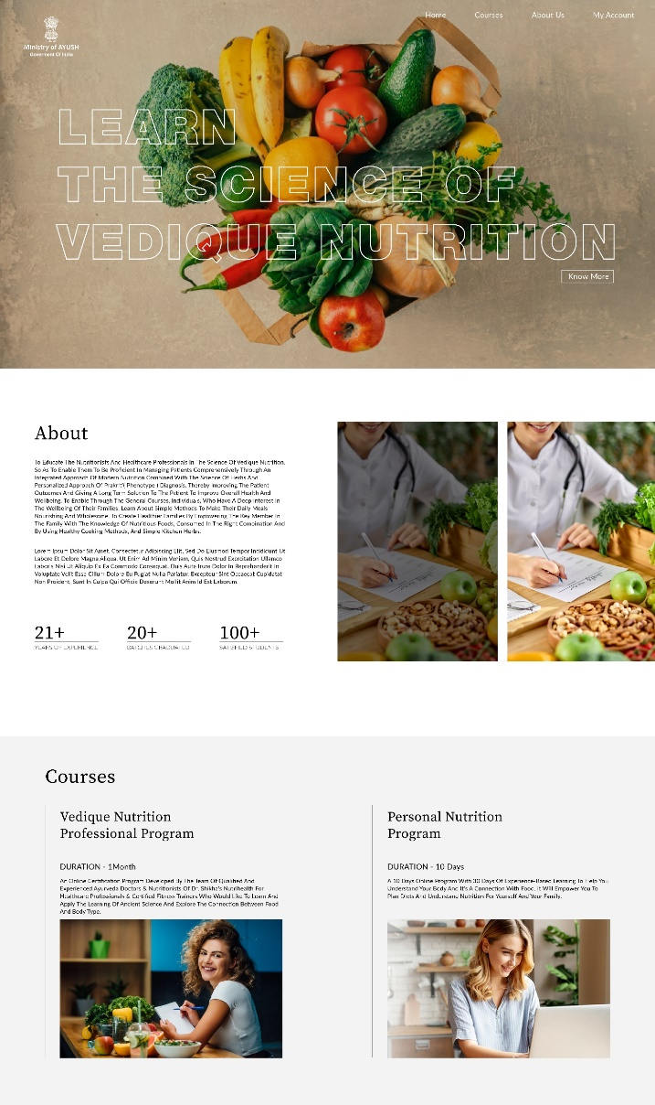

Work Samples
Samples of work, design, Print, Media campaigns.
Regional, National and International.
Samples of Website

Slide 14
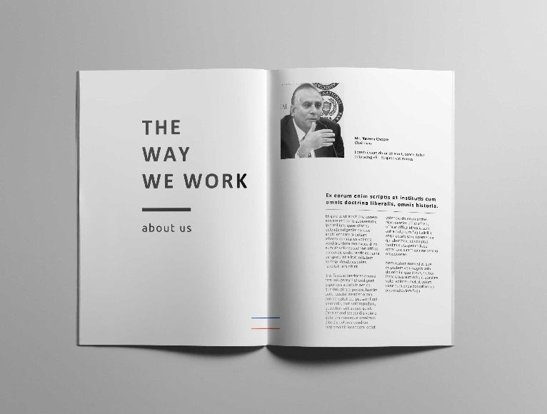


Work Samples
Samples of work, design, Print, Media campaigns.
Regional, National and International.

Slide 15
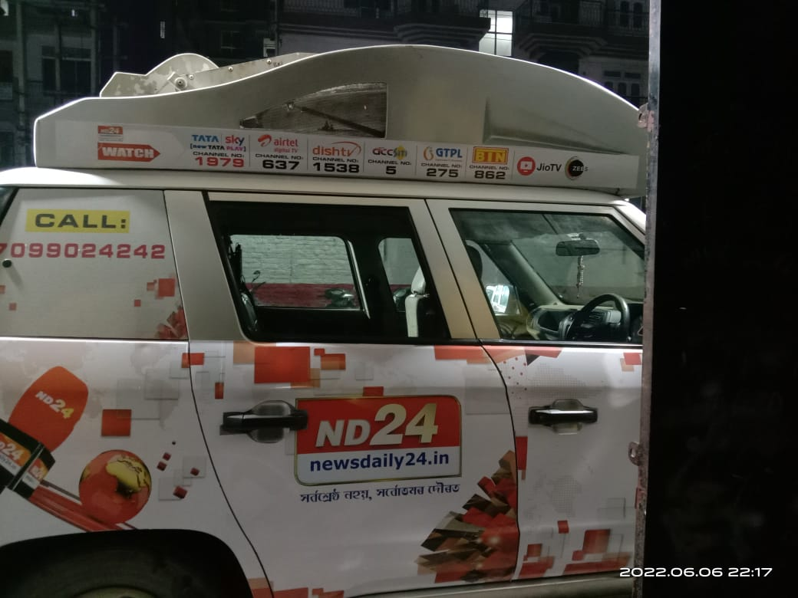
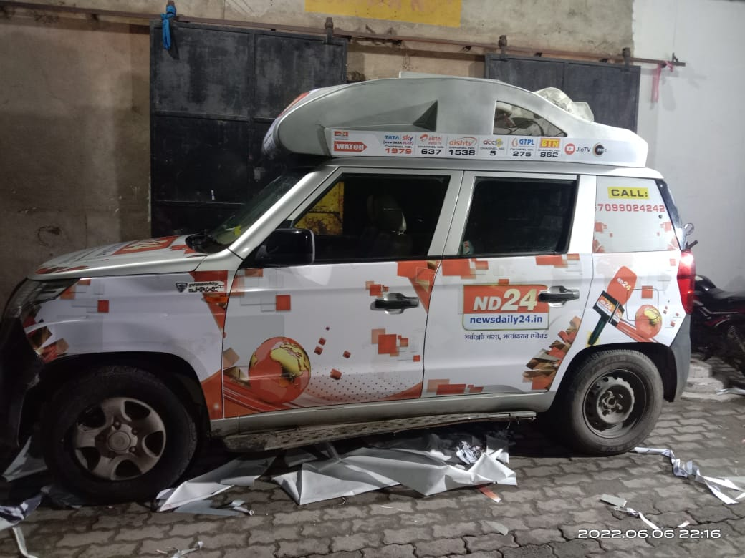
Glimpse Of Our Retail Branding – (Car Branding for ND24 News Channel )

Slide 16
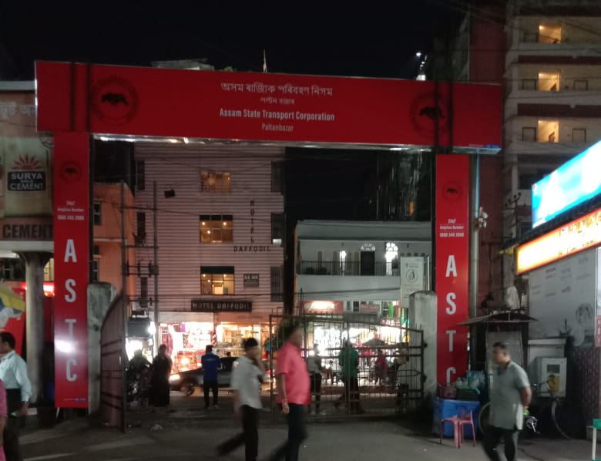
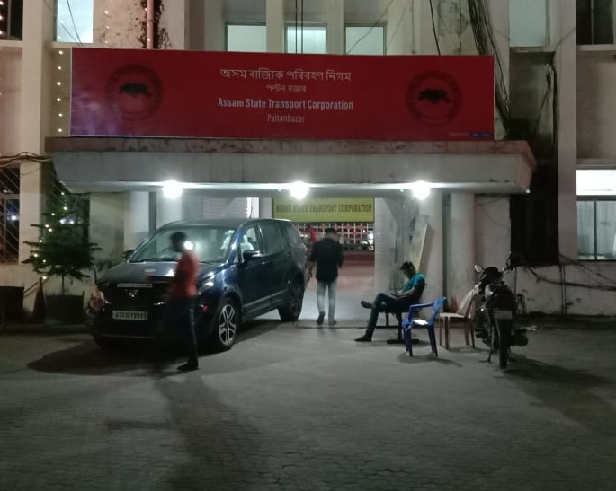
Glimpse Of Our Retail Branding – ( GSB & NLB for ASTC )

Slide 17
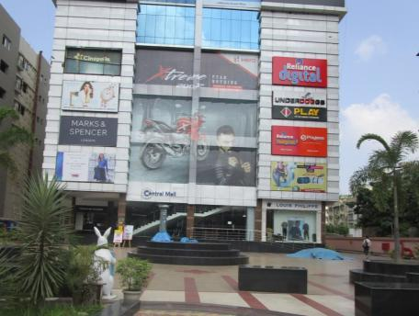
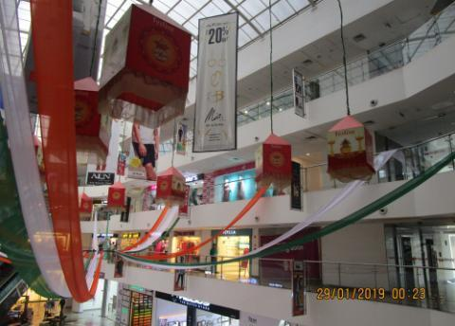
Glimpse Of Our Mall Branding - Guwahati

Slide 18
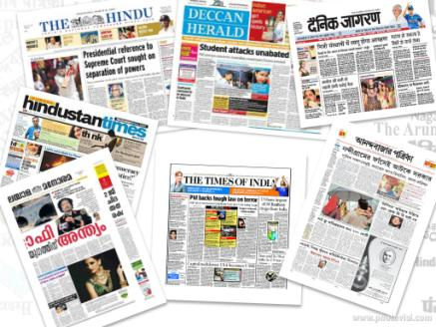
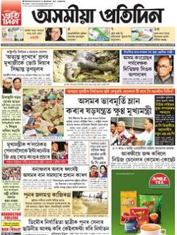


News Paper Advertisement

Slide 19
OUR OUTDOOR BRANDING CAMPAIGN PICTURES

Slide 20
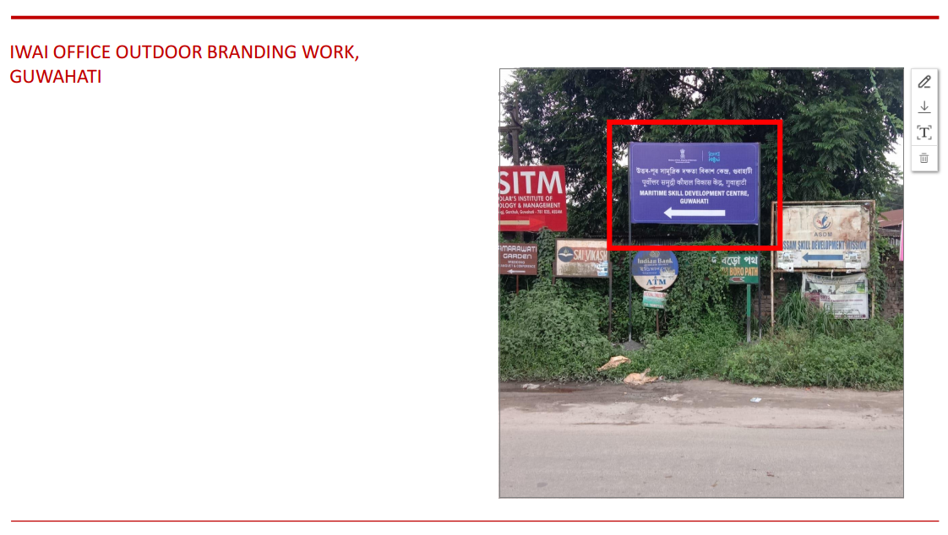

Slide 21
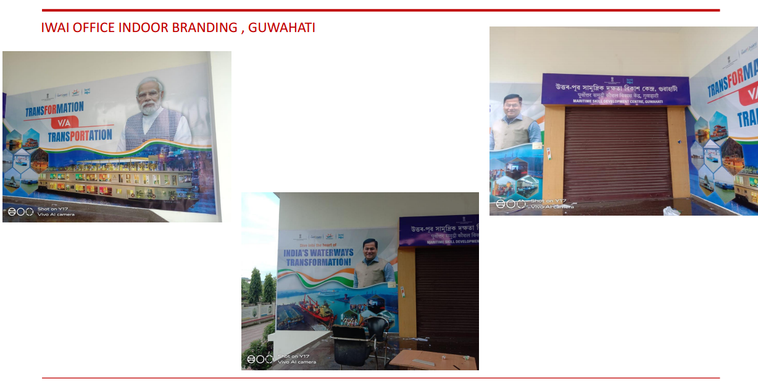

Slide 22
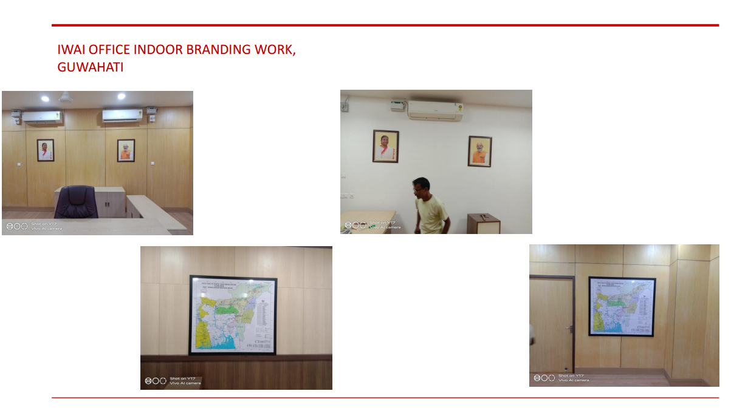

Slide 23
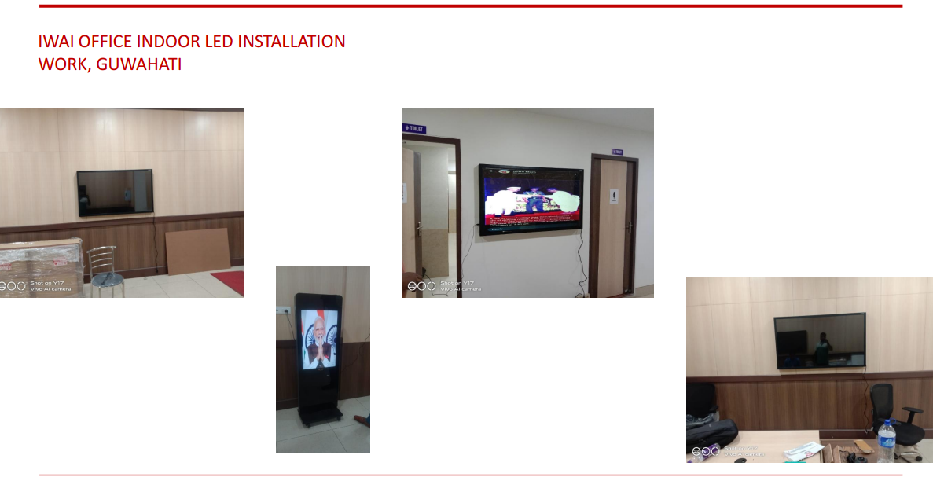

Slide 24
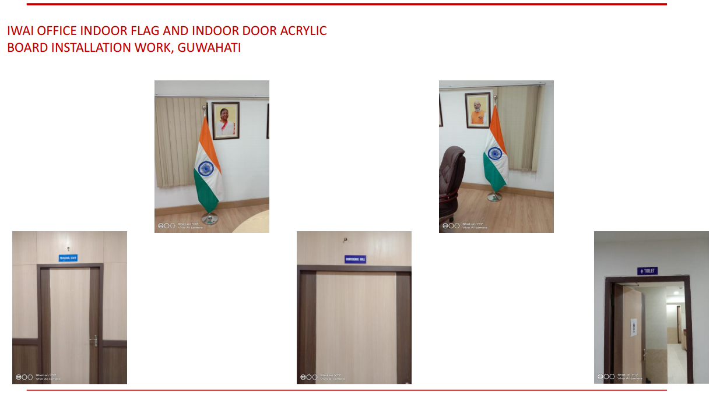

Slide 25
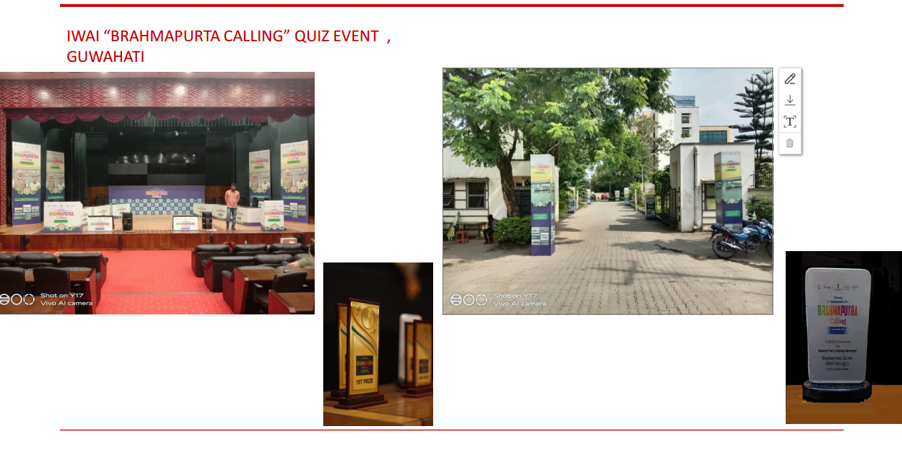

Slide 26
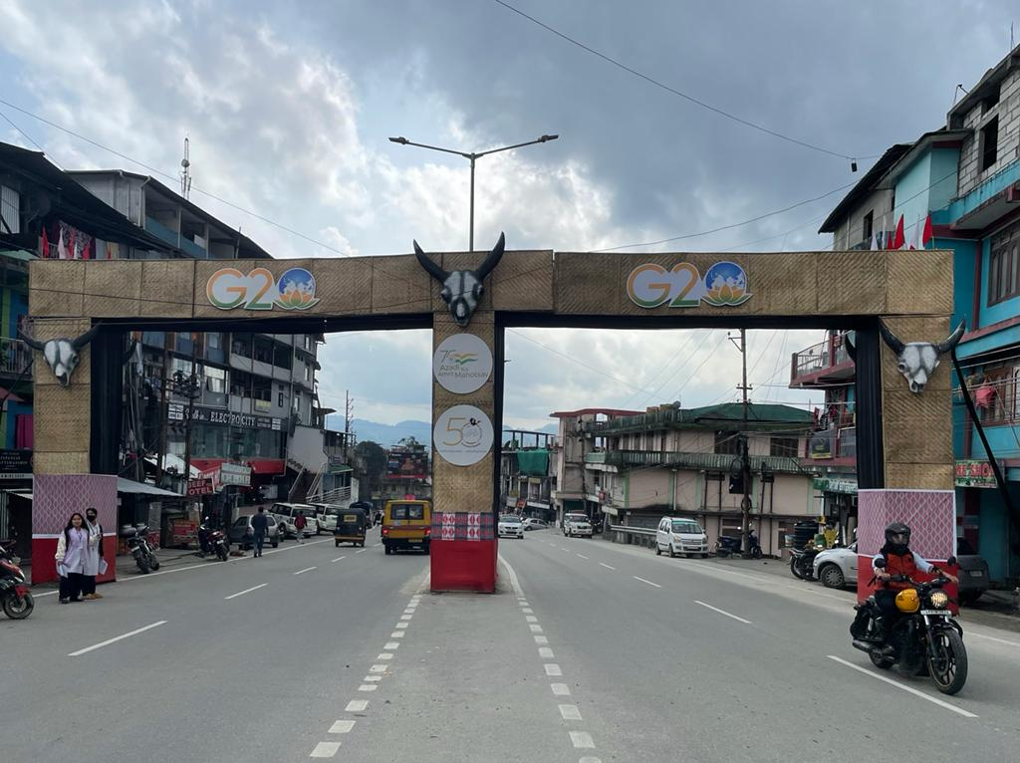
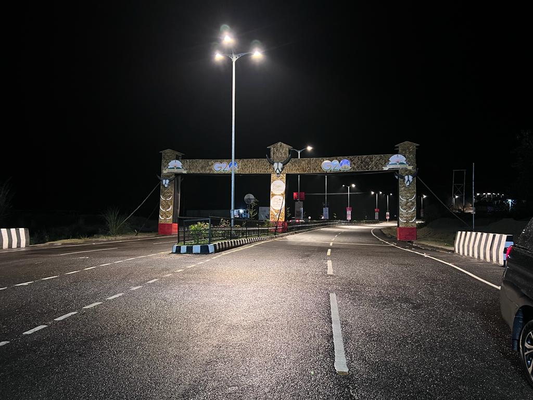
G20 Outdoor branding works, Itanagar, Arunachal Pradesh

Slide 27
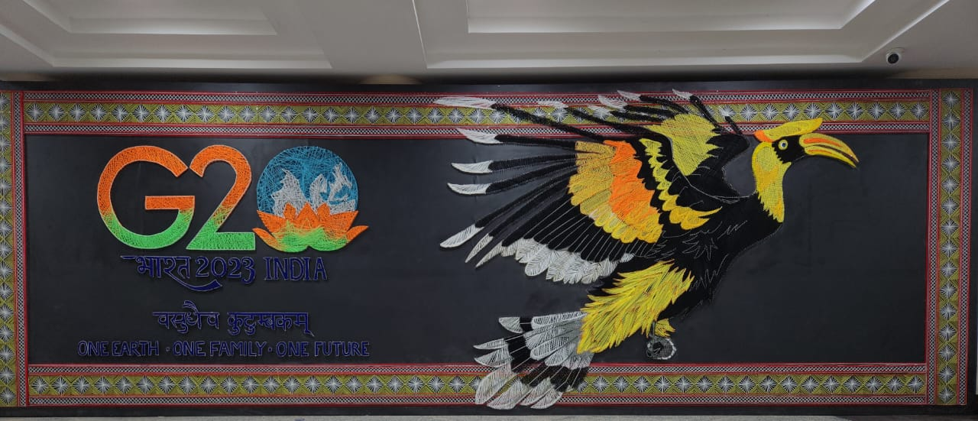
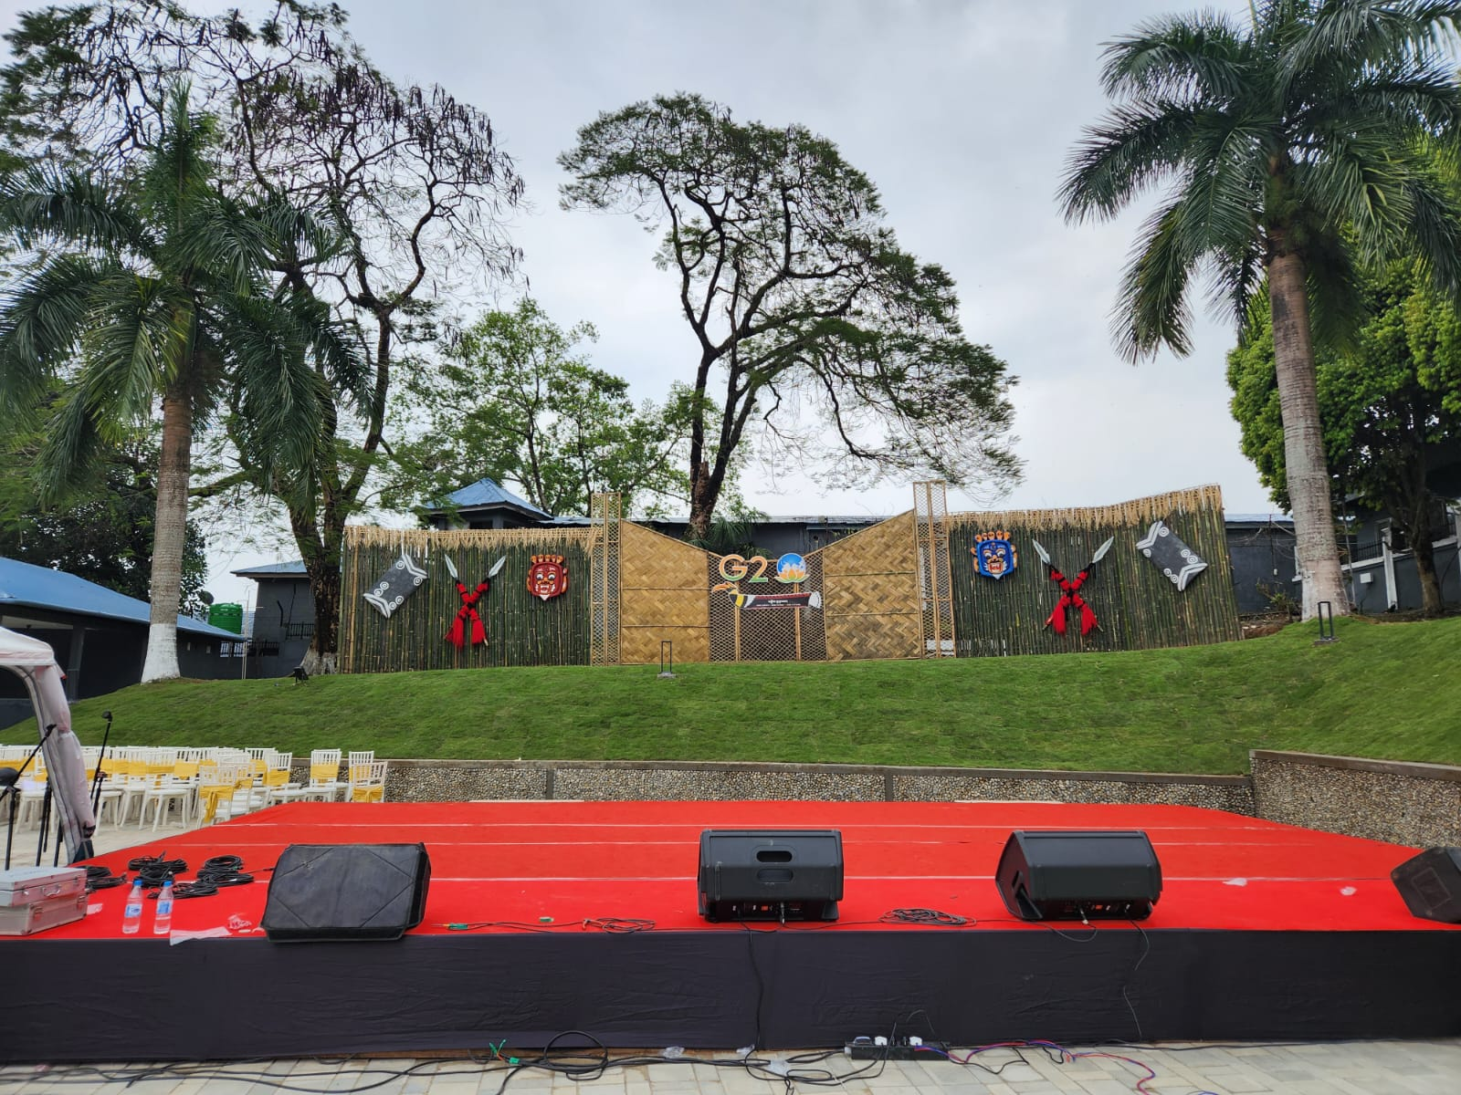
G20 Outdoor branding works, Itanagar, Arunachal Pradesh

Slide 28
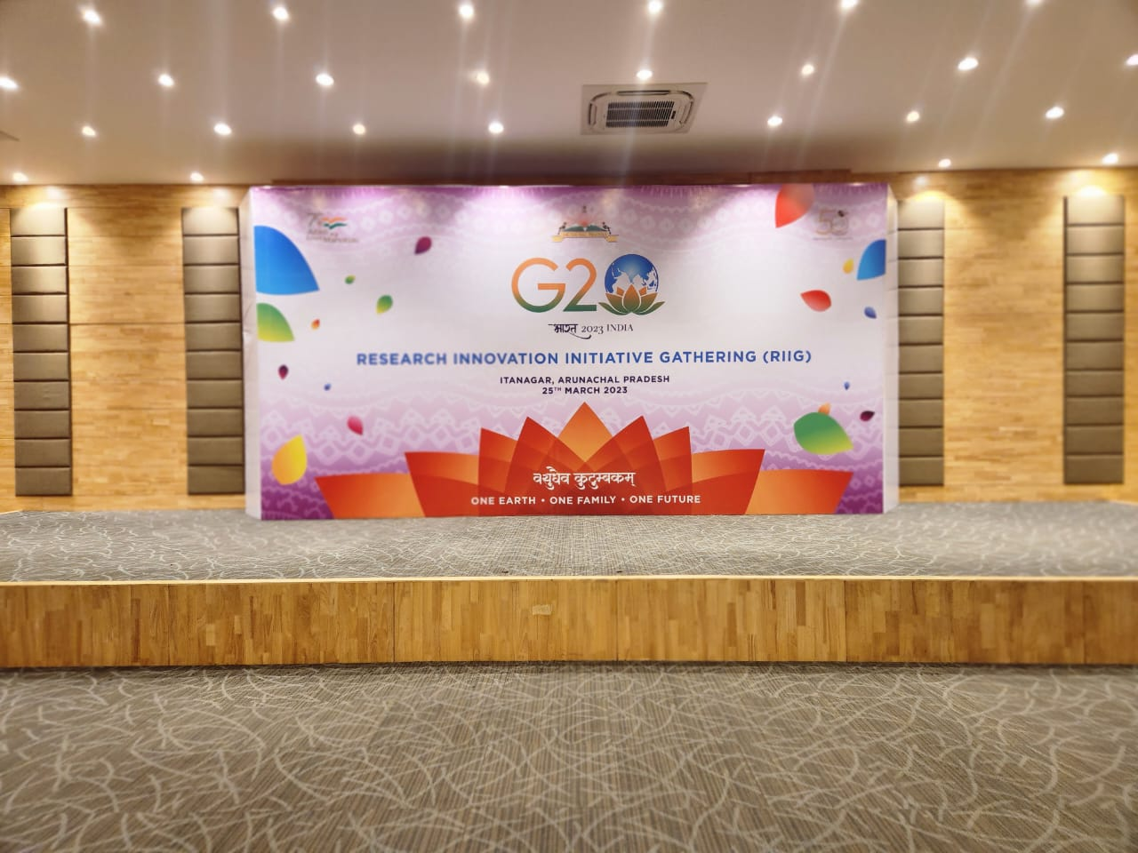
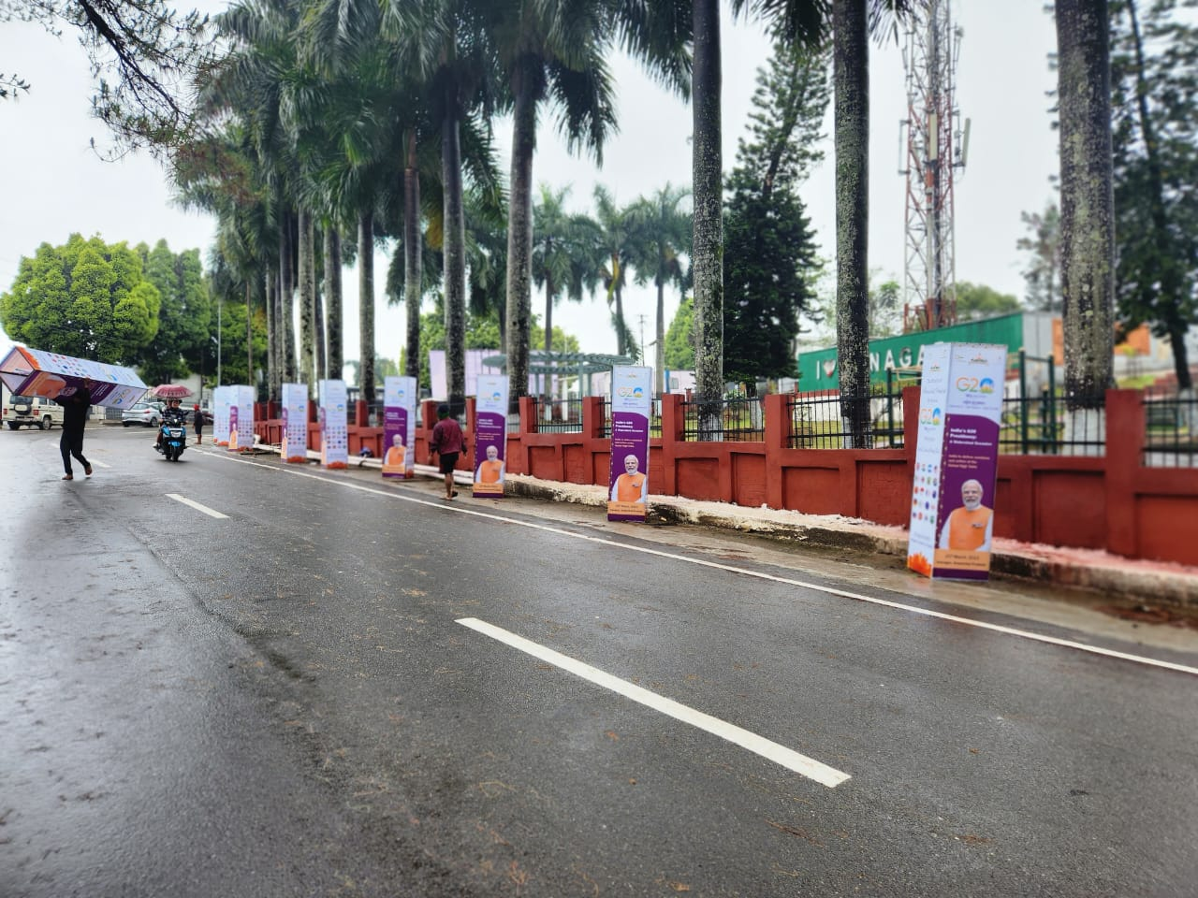
G20 Outdoor branding works, Itanagar, Arunachal Pradesh

Slide 29
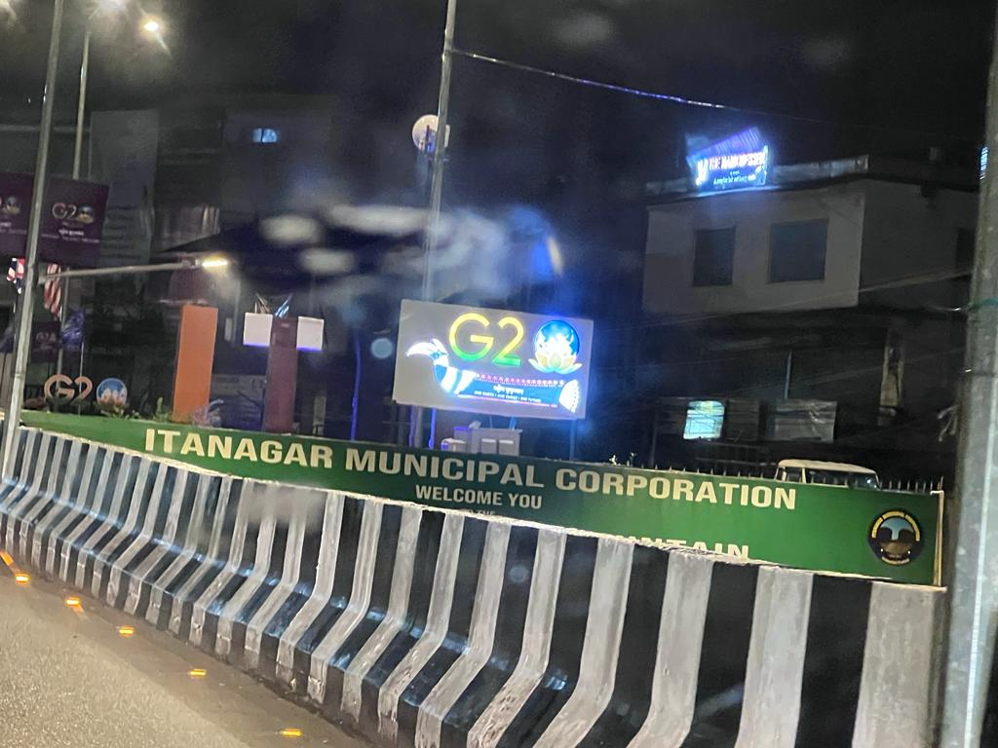
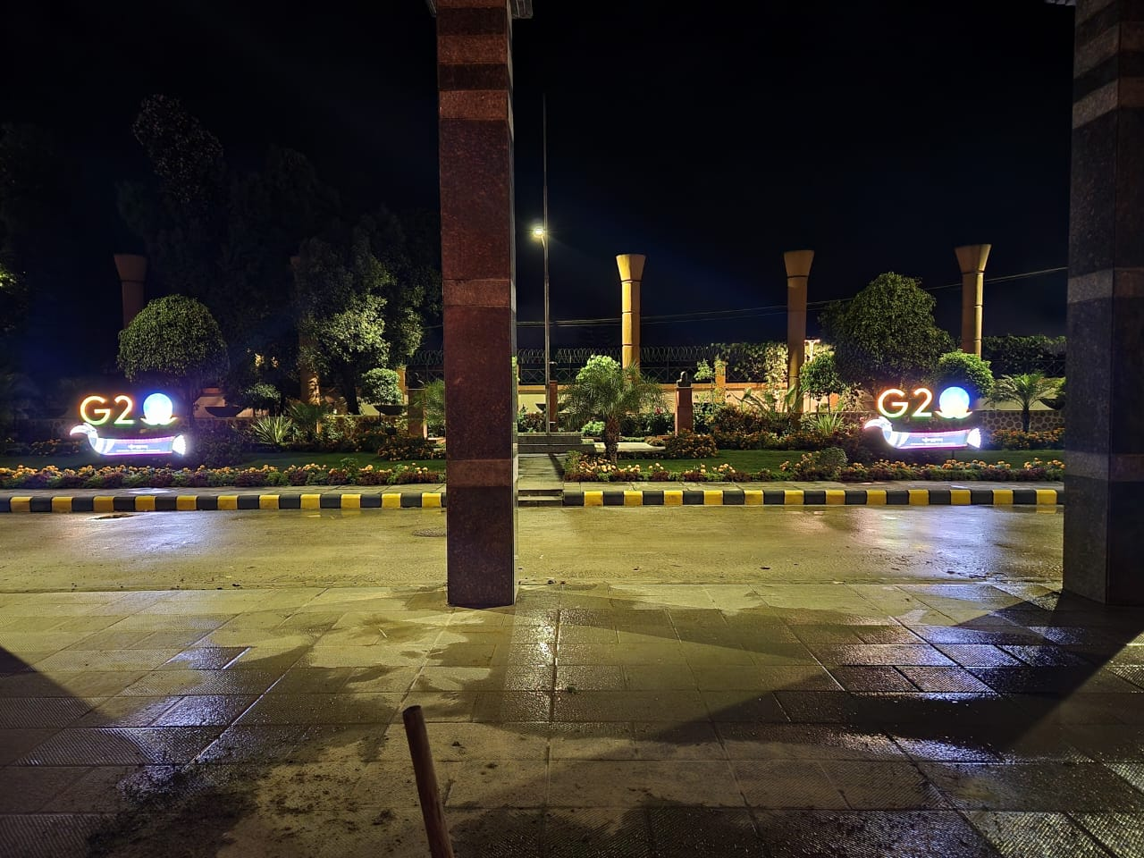
C 20 Outdoor branding works, Namsai, Arunachal Pradesh

Slide 30
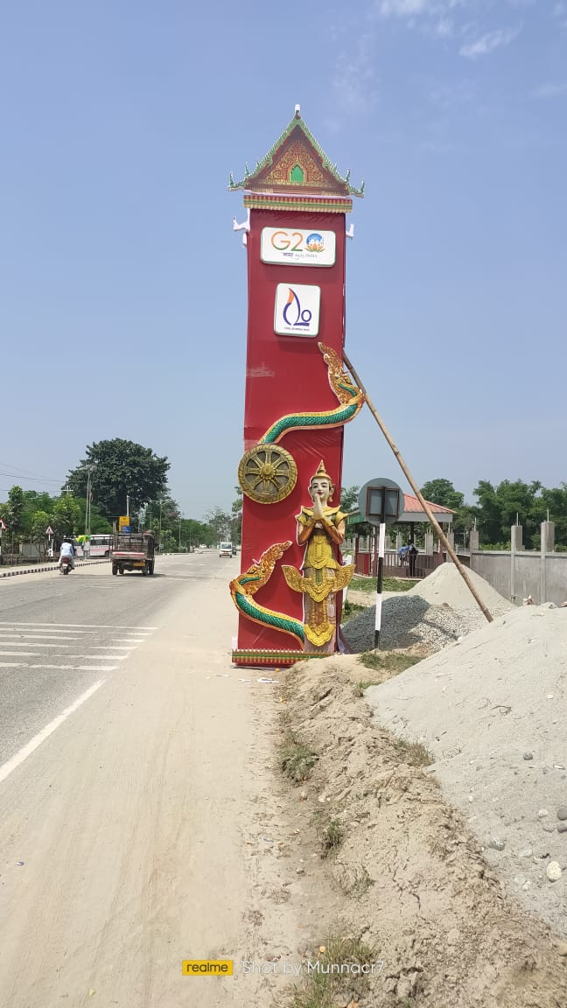
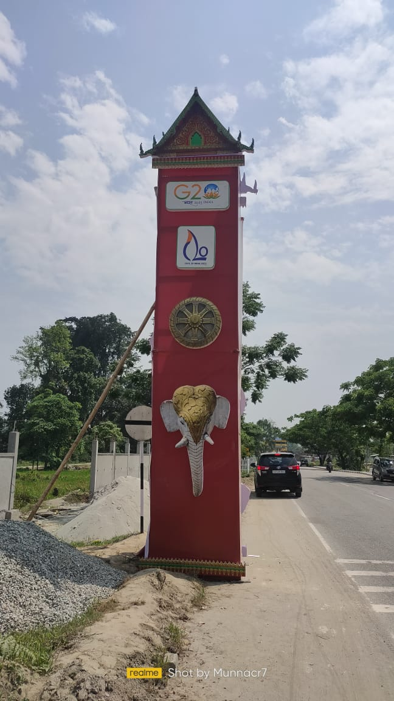
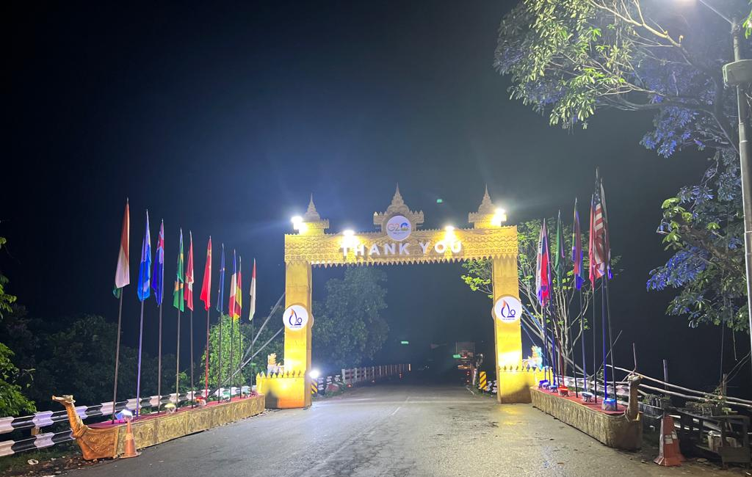
C 20 Outdoor branding works, Namsai, Arunachal Pradesh

Slide 31
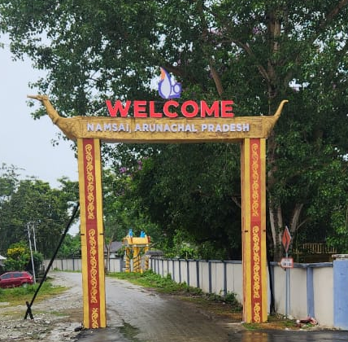
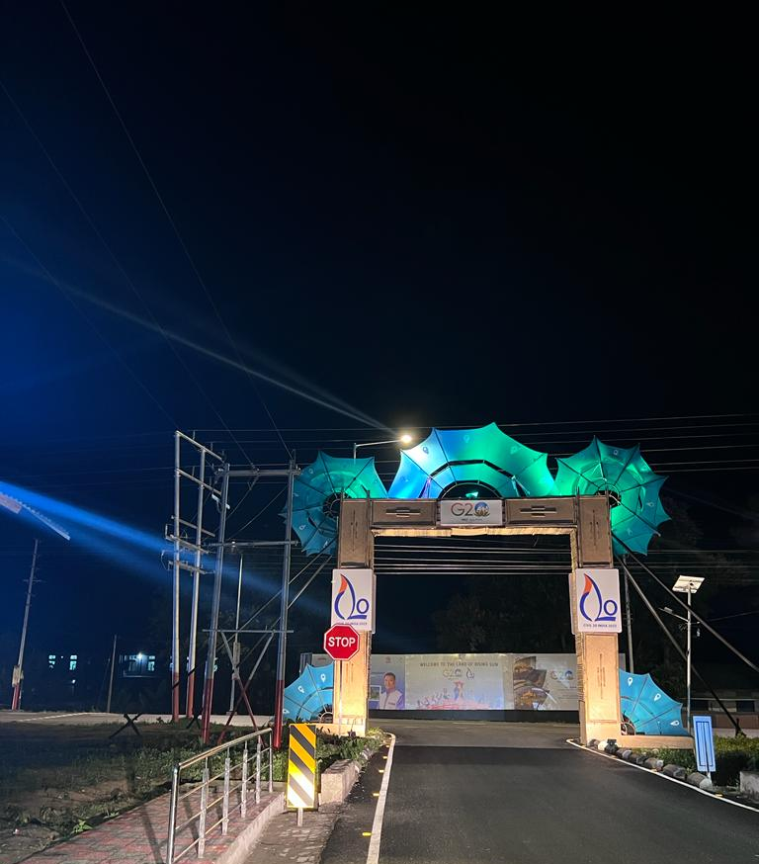
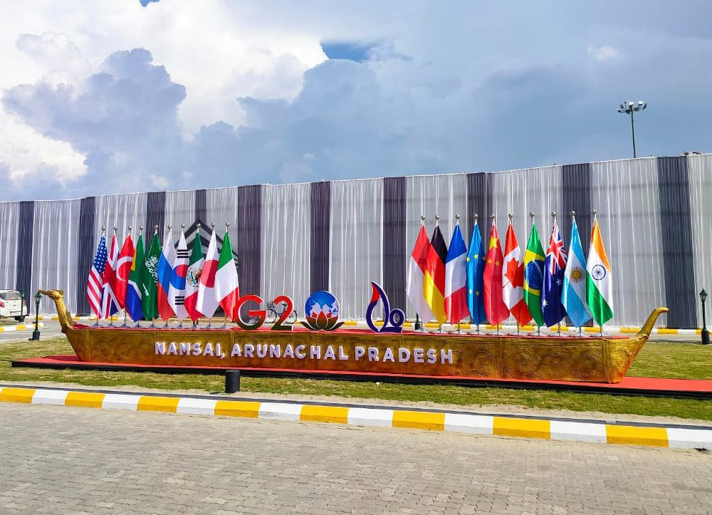
C 20 Outdoor branding works, Namsai, Arunachal Pradesh

Slide 32
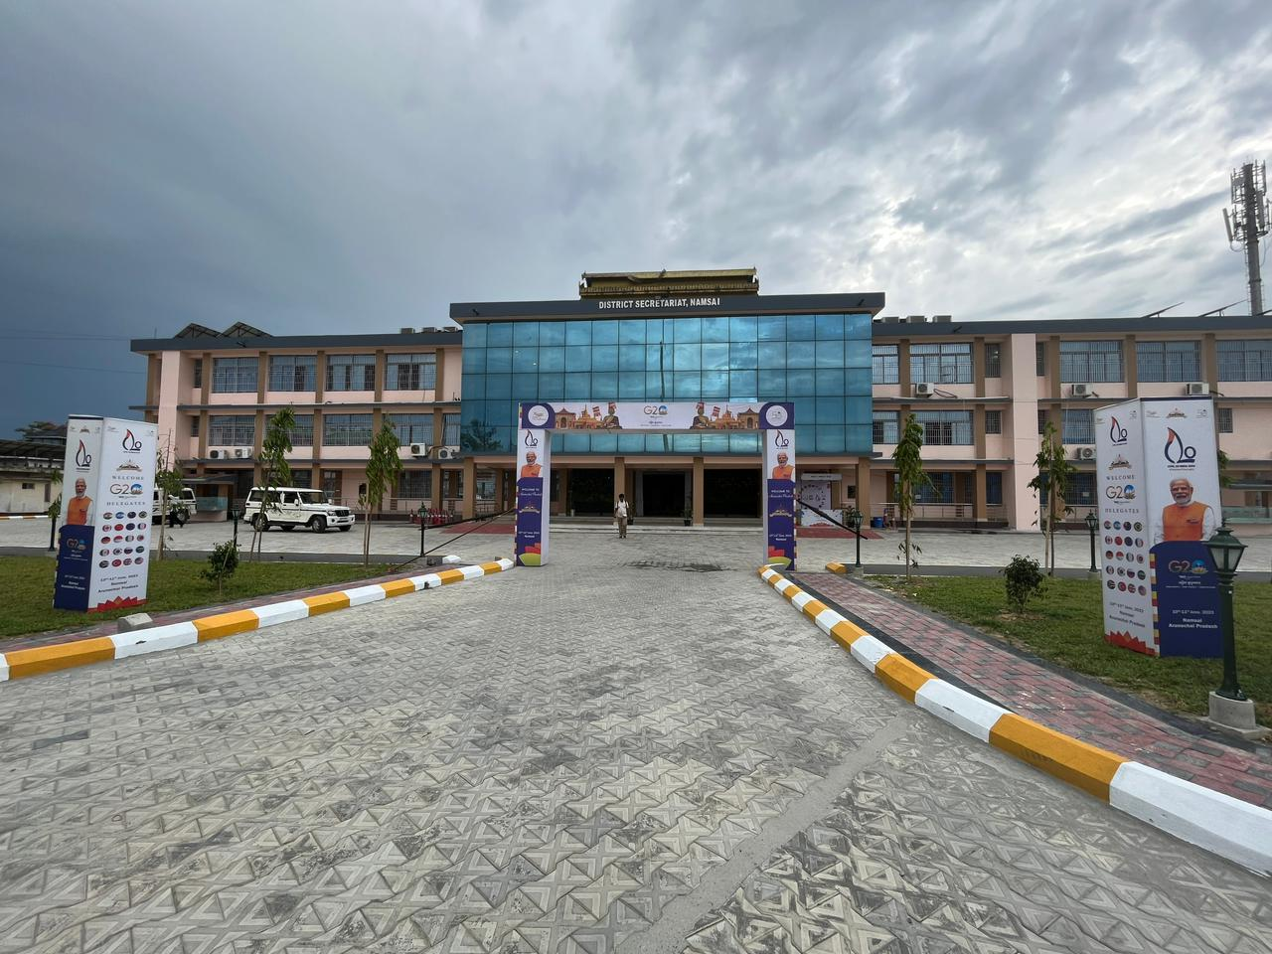
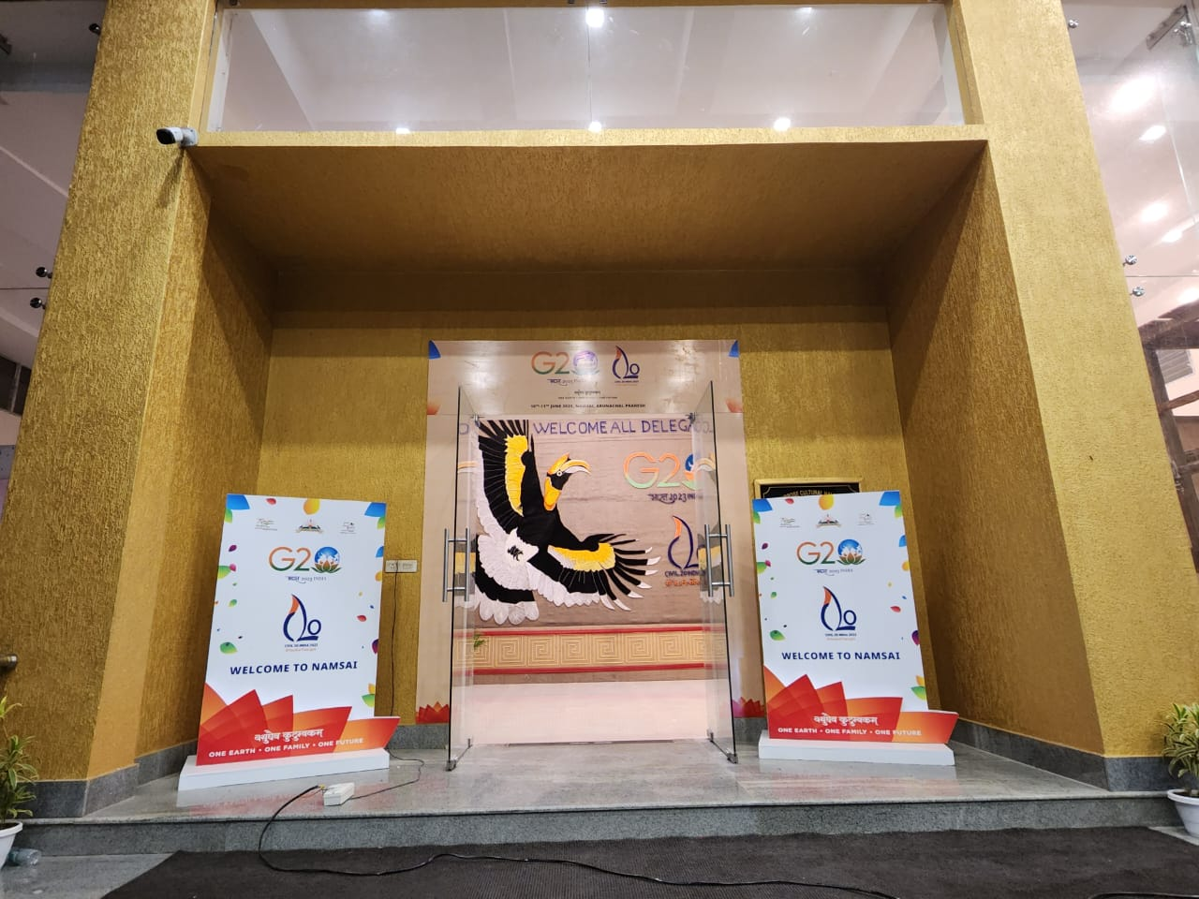
C 20 Outdoor branding works, Namsai, Arunachal Pradesh

Slide 33
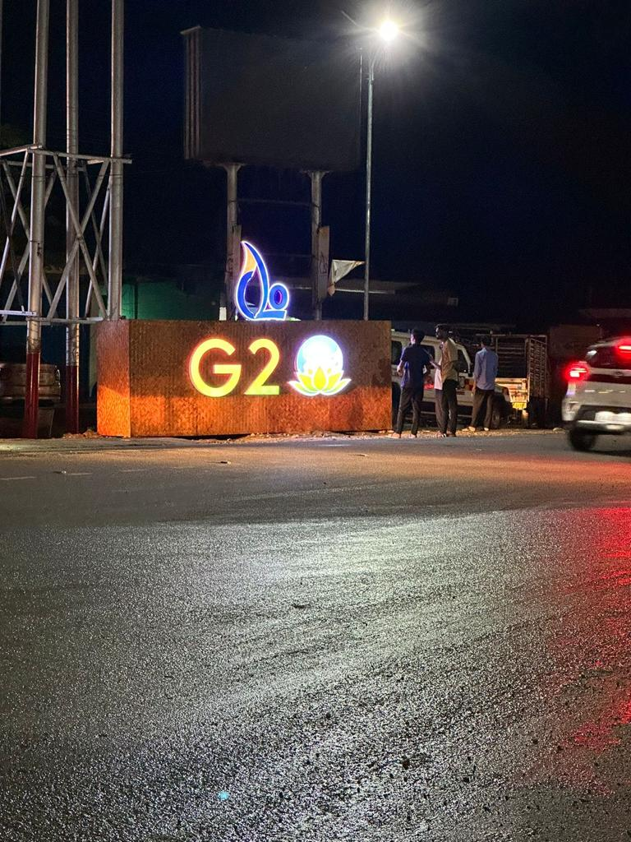
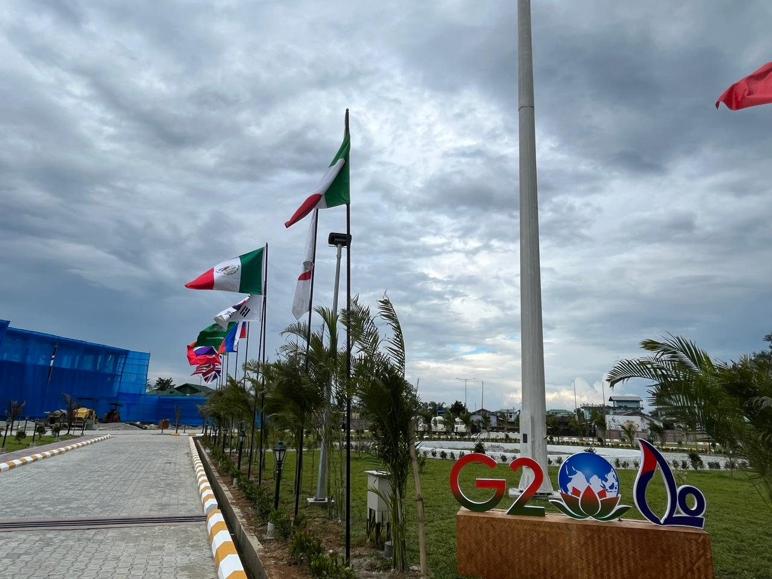
C 20 Outdoor branding works, Namsai, Arunachal Pradesh

Slide 34
OUR OUTDOOR CAMPAIGN PICTURES

Slide 35
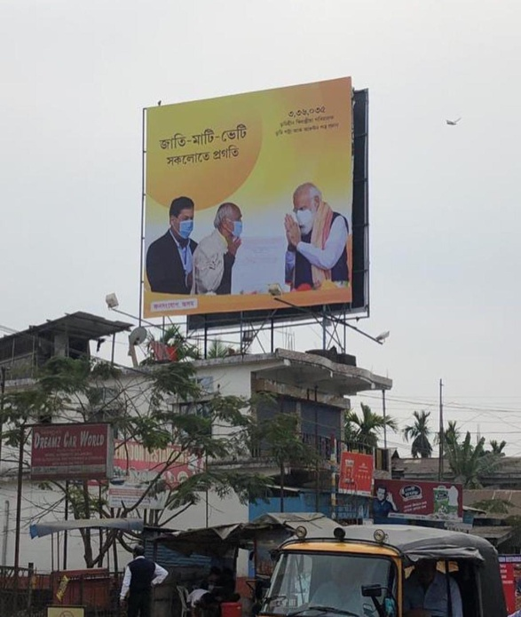
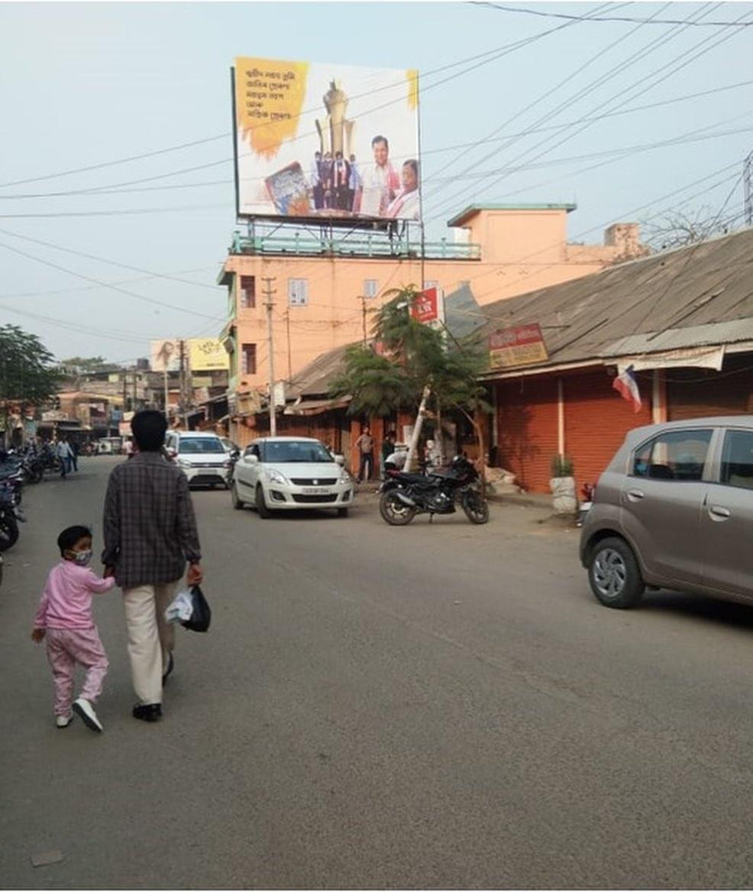
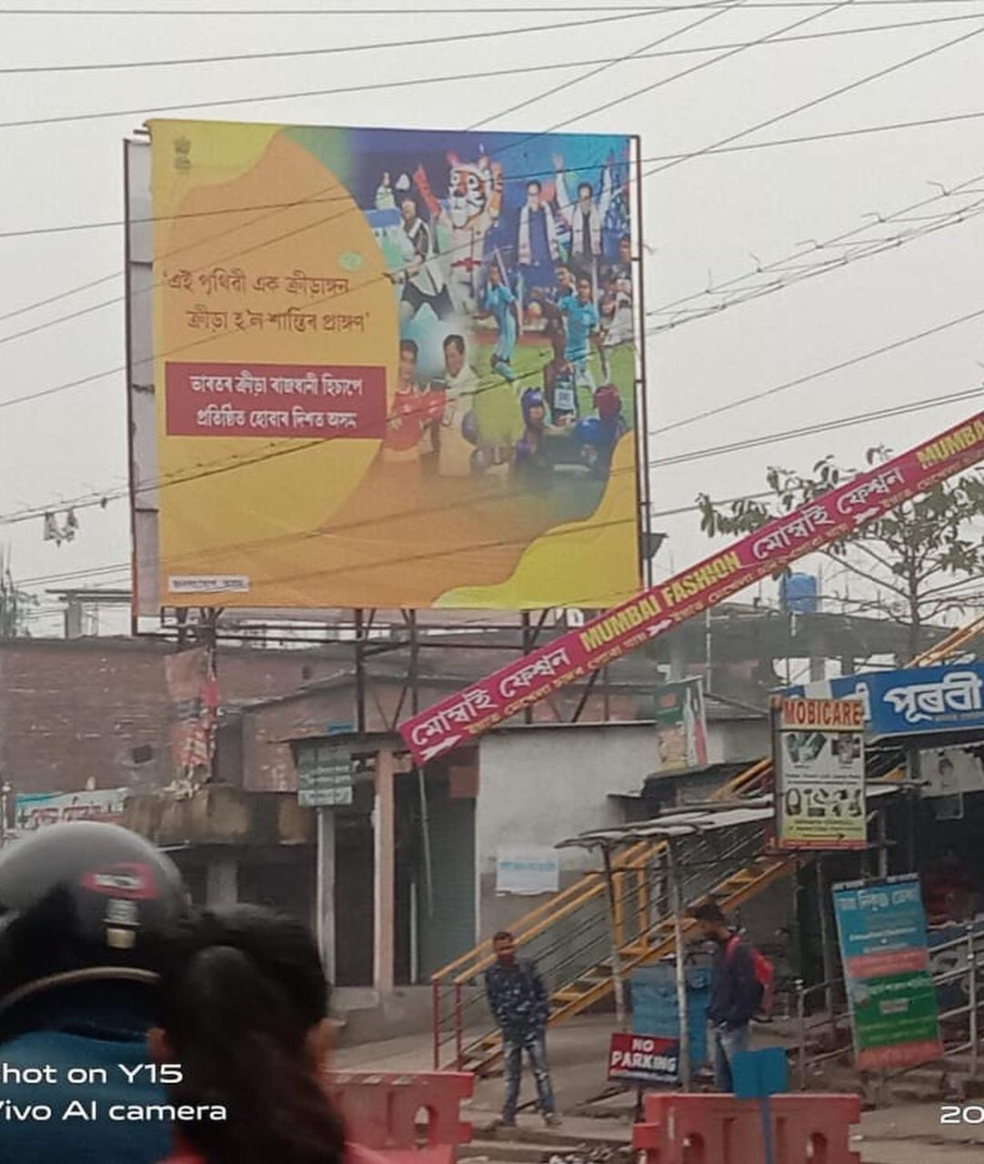
Billboards for DIPR campaign of
No of Hoardings: 310
Locations: 33 districts of Assam

Slide 36
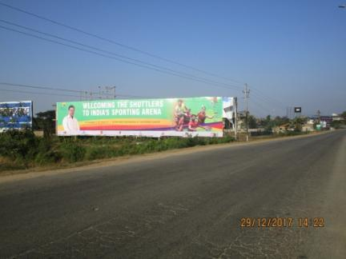
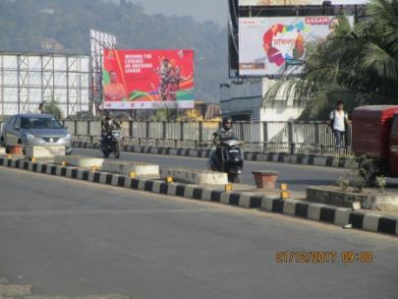
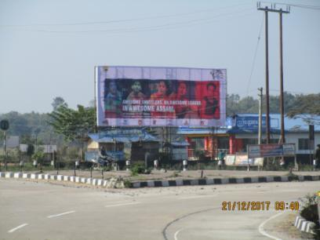
Billboards of PBL Campaign
No of Hoardings: 36
Locations: Guwahati & Other Districts Assam

Slide 37
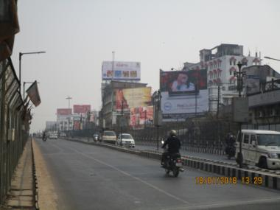
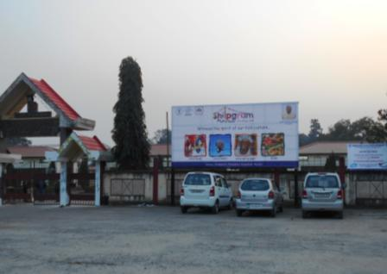
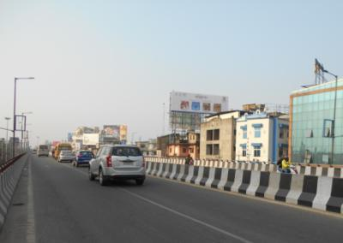
Billboards for NEZCC
No of Hoardings: 16
Locations: Guwahati

Slide 38
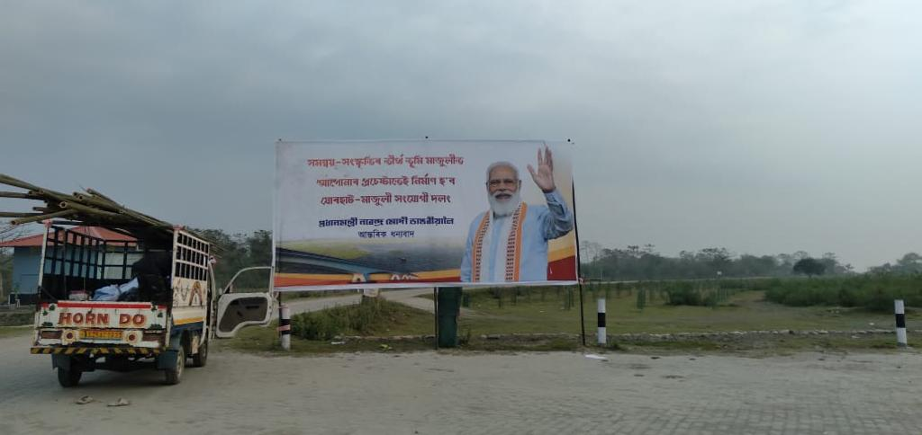
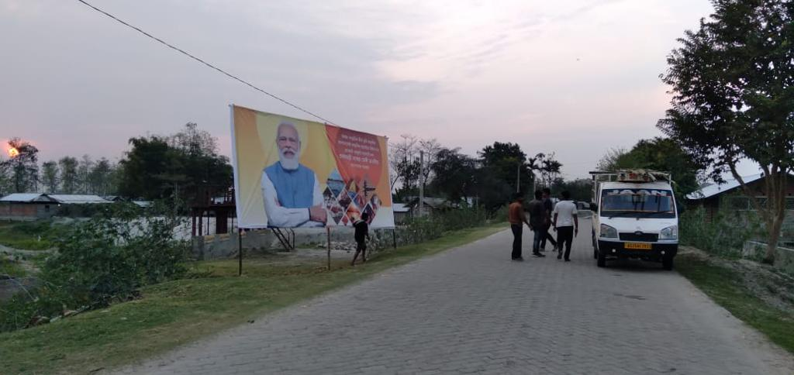


Billboards for NH Department
No. of Hoardings: 210
Location: Majuli

Slide 39



Billboards for Intex Campaign
No of Hoardings: 527
Locations: 7 states of North East

Slide 40




Traffic Signals - Intex Campaign

Slide 41




Unipoles - Intex Campaign

Slide 42



Billboards of Amul Campaign
No of Hoardings: 50
Locations: 15 districts of Assam

Slide 43


Bus – shelters - Amul Campaign

Slide 44



Conceptual Events
EVENTS: Octave Festival, Digha, West Bengal_(Govt. India.)

Slide 45




Conceptual Events
EVENTS: International Tribal Film Festival, West Kameng ,Dirang, Arunachal Pradesh

Slide 46



Conceptual Events
EVENTS: International Tribal Film Festival, West Kameng ,Dirang, Arunachal Pradesh

Slide 47


Conceptual Events
EVENTS: State Arogya Mela 2022, Ministry of Ayush, Govt. of India, Mizoram

Slide 48

Conceptual Events
EVENTS: State Arogya Mela 2022, Ministry of Ayush, Govt. of India, Mizoram

Slide 49


Conceptual Events
EVENTS: State Arogya Mela 2022, Ministry of Ayush, Govt. of India, Mizoram

Slide 50



BTL Activities: MI Roadshow
Road Show which is very interactive and reaches direct to the targeted group. The whole fabrication is customized and different kind of activities can be included. There will be anchor to hold the show and promoters for giving out leaflets and engagement activities.

Slide 51
Thank you!

